Slide 1
COMPUTER VISION EMOTION EXPRESSION BAG OF VISUAL WORD AND DEEP LEARNING
Prepared by:
DO Nhu Tai (176680)
May, 16th, 2018

Slide 2
Agenda
Introduction
Problem 1: Emotion Bag-of-Word Object
Problem 2: Emotion Deep Learning
Problem 3: Emotion Video Extraction
Future Works: Bag-of-Word using Deep Learning
Demo Program

Slide 3
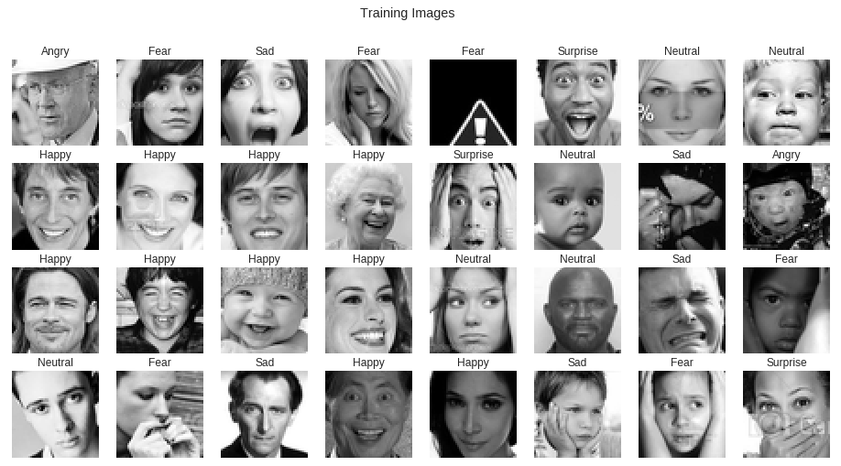
1. INTRODUCTION
1.1. PROBLEMS
Emotion Expression Recognition: FER2013

Slide 4
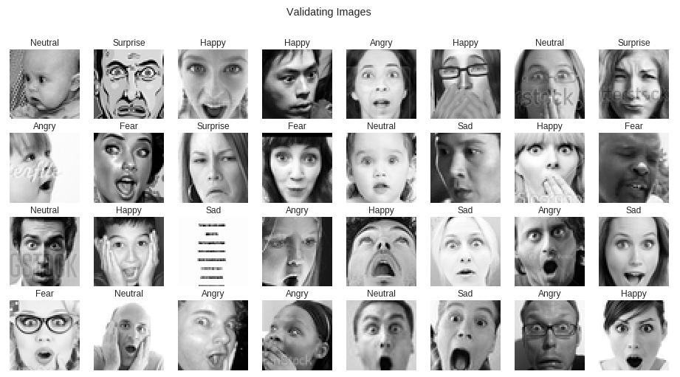
1. INTRODUCTION
1.2. DATASET

Slide 5
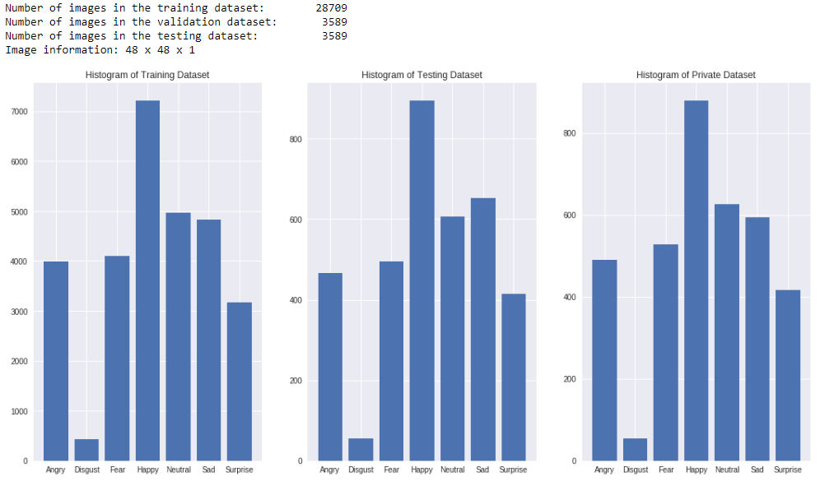
1. INTRODUCTION
1.3. DISTRIBUTION DATASET

Slide 6
2. Prolem 01: Emotion with Bag-of-Word And Sparse SIFT Featur
2.1. Training Process
Extract descriptors using SIFT
Merge descriptors into local patches
Cluster local patches using Mini Batch K-Means to build codewords
Build Feature Histogram Model based on codewords
Normalize Feature Histogram Model
Classify by Multi-Class SVM

Slide 7
2. Prolem 01: Emotion with Bag-of-Word And Sparse SIFT Featur
2.2. Testing Process:
Extract descriptors using SIFT
Match descriptors with K-Means Cluster Center to build codewords for testing image
Create and normalize Feature Histogram Model for Image Codewords
Predict by Multi-Class SVM

Slide 8
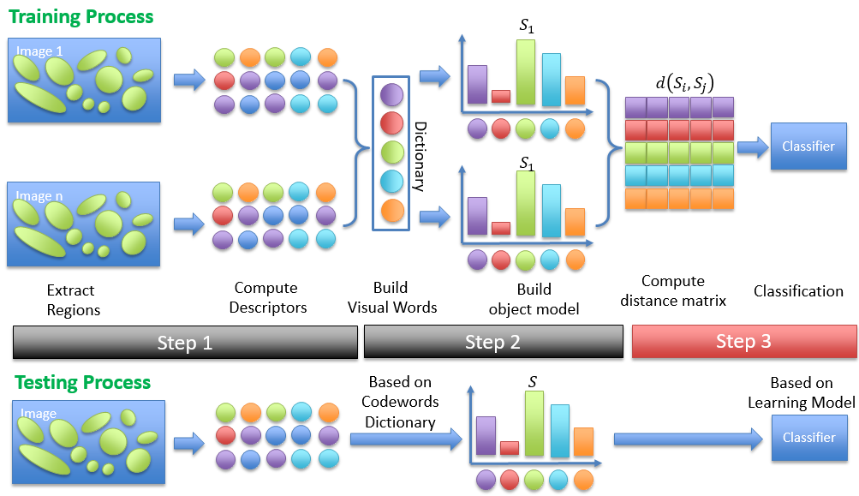
2. Prolem 01: Emotion with Bag-of-Word And Sparse SIFT Featur
2.3. Process:

Slide 9
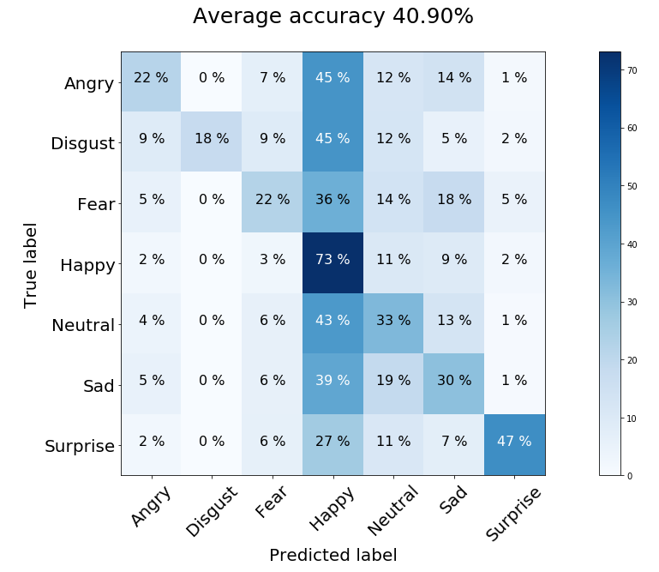
2. Prolem 01: Emotion with Bag-of-Word And Sparse SIFT Featur
2.4. Results:

Slide 10
3. Prolem 02: Emotion with Deep Learning
3.1. Deep Learning CNN-Like-VGG16 Model:
Block 1 – 3 Conv2D (64, (3,3)), MaxPooling (2,2), Dropout (0.2)
Block 2 – 4 Conv2D (128, (3,3)), MaxPooling (2,2), Dropout (0.2)
Block 3 – 4 Conv2D (256, (3,3)), MaxPooling (2,2), Dropout (0.2)
Classifier – Flattern, Dense (1024), Dropout(0.5), Dense(7, SoftMax)

Slide 11
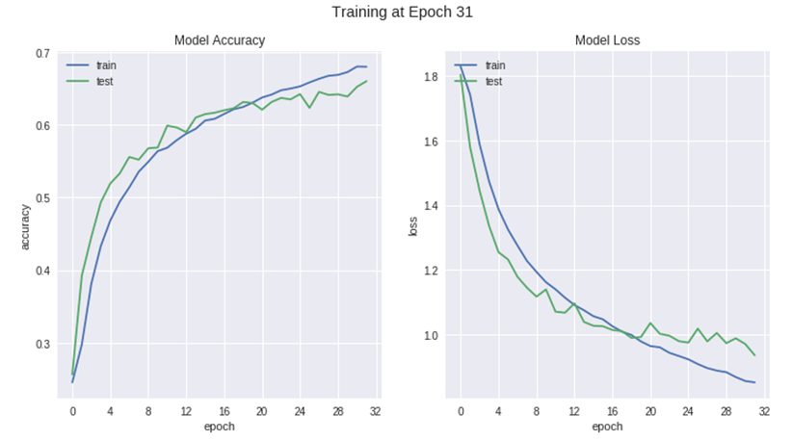
3. Prolem 02: Emotion with Deep Learning
3.2. Training History

Slide 12
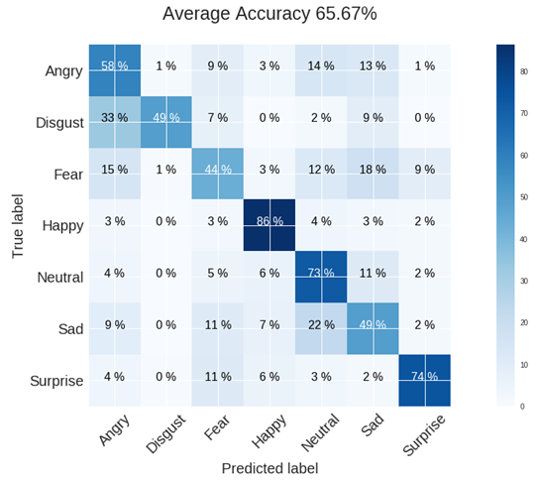
3. Prolem 02: Emotion with Deep Learning
3.3. Results:

Slide 13
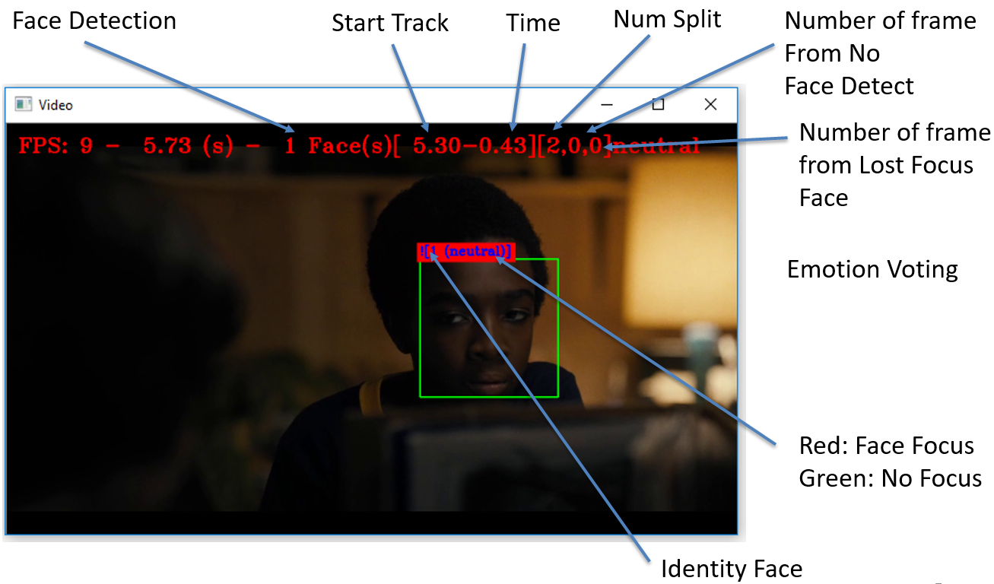
4. Prolem 03: Video Emotion Extraction
4.1. Program Description:
Extract small video clips in a video and vote video emotion of small clips

Slide 14
4. Prolem 03: Video Emotion Extraction
4.2. Program Features:
Console Program with Modules
Emotion MLCNN,
Face Detection Dlib, OpenCV, MTCNN,
Face Matching using Hungarian Method,
Face Description with VGG Face

Slide 15
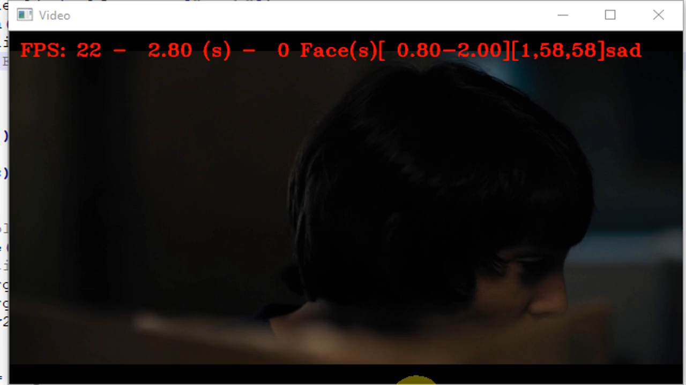
4. Prolem 03: Video Emotion Extraction
4.3. Demo:

Slide 16
5. Future Works
Bag-of-Word using Deep Learning
Use CNN Model for feature extraction (old: SIFT)
Use RNN for building histogram model (old: K-Means)

Slide 17
THANKS FOR LISTENING!
Waiting for question!

